Slide 1
Writing positive messages

Slide 2
Topics to discuss:
What are routine positive messages, characteristics and types.
Structure and use of techniques used in writing positive messages.
Sample good news messages, requests, adjustments and complaints.
Kindness and goodwill messages, sympathy messages, their kinds.
The five Ss technique to write kindness or goodwill messages. .

Slide 4
Blocked format Sample outline:
23 North Main Street
ABC Colony
Post Box no. 253447
kARACHI-4004800
February 23, 2010
Dr. ABC
Customer Relations
ABC Company
154 Petal Street
Mumbai-4004800
BALANCE PAYMENT ALREADY MADE
I-----------------------------------------------------------------------------------------
----------------------------------------------------------------------------------------
----------------------------------------------------------------------------------------
Sincerely
xyz
Encl: copy of cancelled checque
Sender`s details
Receiver's details
Subj
Opening
Body
closing
Complementary close
Enclosure

Slide 5
Routine/Positive Messages
Positive messages include:
Routine messages where the audience is expected to react in a neutral to positive manner.
Consist of routine or good news.
Items such as congratulations, confirmations, directions, simple credit requests, or credit approvals, Instructions, explanations, direct claims and denials that are somewhat routine or expected and sympathy messages since the do not surprise the reader.
Identify your audience and the purpose first, then choose what type of letter fits both.

Slide 6
Consider the message to be a positive message structure when:
The receiver likes or expects this news (product shipped on time).
The receiver needs little education or background to understand the news (travel arrangement for the conference)
The receiver considers the message routine, even if not completely positive.

Slide 7
Direct vs indirect approach
DIRECT APPROACH
The main idea (recommendation, gist, conclusion or request) comes on the "top" of the document, followed by the evidence.
This is a deductive argument approach used when your audience will be neutral or positive about your message.
Start with a summary of your key findings, conclusions, and recommendations.
INDIRECT APPROACH
The evidence is presented first, leading therefore to the main idea. This is an inductive argument.
This approach is best if your audience may be displeased about or may resist what you have to say, or are skeptical or hostile, or a junior writing to senior.
Introduce your complete findings and discuss all supporting details before presenting your conclusions and recommendations.

Slide 8
Direct vs indirect approach
DIRECT APPROACH
Most popular and convenient for business reports. It saves time and makes the rest of the report easier to follow.
The direct approach also produces a more forceful report. You sound sure of yourself when you state your conclusions confidently at the outset
INDIRECT APPROACH
By deferring the conclusions and recommendations, you imply that you’ve weighed the evidence objectively without prejudging the facts.
You also imply that you’re subordinating your judgment to the audience, whose members are capable of drawing their own conclusions when they have access to all the facts.

Slide 9







Channels Used for
Positive Messages
© 2015 Cengage Learning. All Rights Reserved. May not be scanned, copied or duplicated, or posted to a publicly accessible website, in whole or in part. © mostafa fawzy/Fotolia, © Marina Zlochin/Fotolia, © Dark Vectorangel/Fotolia
E-mails
Memos
Letters
Social media networks
Blogs
IM and text messages

Slide 10

Effective Positive Messages and the Writing Process
Phase 1:
Analysis, Anticipation, and Adaptation
© 2015 Cengage Learning. All Rights Reserved. May not be scanned, copied or duplicated, or posted to a publicly accessible website, in whole or in part. © Iadam/Fotolia
Do I really need to write this e-mail, memo, or letter?
Why am I writing?
How will the reader react?
What channel should I use?
How can I save my reader’s time?

Slide 11

Effective Positive Messages and the Writing Process
Phase 2:
Research, Organization, and Drafting
© 2015 Cengage Learning. All Rights Reserved. May not be scanned, copied or duplicated, or posted to a publicly accessible website, in whole or in part. © denis_pc/Fotolia
Collect information.
Choose the best organizational strategy.
Compose the first draft.
Group similar information together.
Keep your paragraphs short.

Slide 12

Effective Positive Messages and the Writing Process
Phase 3:
Revision, Proofreading, and Evaluation
© 2015 Cengage Learning. All Rights Reserved. May not be scanned, copied or duplicated, or posted to a publicly accessible website, in whole or in part. © denis_pc/Fotolia
Is the message clear?
Is the message correct?
Did you plan for feedback?
Will this message achieve its purpose?

Slide 13
Sample Tasks for positive messages.
Suppose that you are a general manager at ABC Logistics. Write an appreciation letter to Mr. Ali for his positive performance and for his promotion he has got. Remember, Ali is an assistant manager at the distribution department.
2. A farmer at your Agricultural farm has requested you (the equipment distributor) to grant him a line of credit so that he can purchase global positioning systems for his combine harvester machines and tractors.
Suppose that you are the equipment distributor. After discussing several reasons you have decided to grant the farmer’s request. Write a positive letter to inform him of the good news.
3. Assume that you have received a request from an NGO asking for donation. The current situation of your company is stable enough to donate. Accept the request and inform the requester writing a good news message in the form of a letter using ______________ approach. Instructions:
1. Following all the formalities of a good/bad news (positive/negative message), write a short letter.
2. Inclusion of irrelevant information will lead to marks deduction.

Slide 14
Strategy for Routine Information/Requests
First paragraph
(Opening)
State information/Request
Assume Compliance
(Body) Second paragraph
Explain and Justify Request
Breakdown Complicated Requests
Third paragraph
(Closing)
Request Specific Action
Express Appreciations
State purpose.
End with courteous close

Slide 15
Common Examples of Routine Requests
Asking for information and action
Making claims and requesting adjustments
Asking for recommendations

Slide 16
1/3. Asking for Information and Action
Most simple requests can be handled with three message points:
Request/Main Idea- what you want to know or what you want the reader to do (politeness)
Reasons/explaination- Why you’re making the request. Justify the request and explain purpose with courtesy.
Reader benefit/motivation and polite close- Why it may be in your reader’s interest to help you. Clear action.
First paragraph
Second paragraph
Third paragraph

Slide 17
Answering Requests for Information or Action
Subject Line:
Identify the topic and any previous correspondence. Use verb phrases without articles.
First paragraph-open
Open directly with main idea; major statement or question ( purpose- of adjustment, statement of order or reservation). Why this person? For good news, do so promptly.
Second paragraph
Explain the subject logically. Justify you requests with reasons. Add details that help reader to respond correctly. Use lists, tables, headings, boldface, italics, numbers, or other graphic devices to improve understanding. Use “you” attitude, faith in reader, promote company`s product/service.
Third paragraph
Mention clear action or request-WHAT and WHEN. Make it easy- provide reply envelope, office hours etc. State the remedy and appreciate. Close courteously and be cordial to build goodwill.
Avoid cliché endings (If you have any other questions, don’t hesitate to call).

Slide 18
TASK: Review the positive message letter given on page 87 and 88.

Slide 19
TASK: MODIFY THE FOLLOWING REQUEST EMAIL AND MAKE IT MORE AN EFFECTIVE REQUEST.
To: Kim Johnson <kjohnson@smi.com>
From: Tim Rudolph <trudolph@smi.com>
Subject: New Policy
This e-mail is written to inform you that I continue to receive disturbing reports about the misuse of e-mail by employees. In the course of the past three months I have heard of defamatory messages, careless downloads, and even a basketball pool that turned into a gambling operation.
In view of the foregoing, I am herewith instructing your office that an e-mail policy for the staff is needed. By October 1 a rough draft of a policy should be forthcoming. At the very minimum it should inform each and every employee that e-mail is for business only. Employees must be told that we reserve the right to monitor all messages. No pictures or attachments should be in the e-mail system without there being a valid reason. And we should not be using e-mail to be saying anything about personnel matters—such as performance reviews and salaries.
If you have any questions, do not hesitate to call.

Slide 20
Improved.
To: Kim Johnson <kjohnson@smi.com>
From: Tim Rudolph <trudolph@smi.com>
Subject: Developing Staff E-Mail Policy
Please draft a policy outlining appropriate e-mail use for employees.
We need such a policy because I have received reports of misuse including defamatory messages, careless downloads, and even gambling. Here are a few points that the policy should cover:
E-mail is for business use only.
E-mail messages may be monitored.
No pictures or attachments should be sent without a valid reason.
E-mail should not be used to discuss personnel matters.
Please submit a draft to me by October 2 because we hope to have a final policy completed by November 5. Call if you have questions.

Slide 21
2/3. Making claims and adjustments
A claim letter is a letter written to resolve problems on errors that were made and may need an adjustment.
An adjustment message is a response to a claim letter that was made against your business.
In order to write claim and adjustment letters:
Plan and develop a simple outline to remain organized.
Decide what you want the reader to do. For example, do you want your money back or the product be replaced?

Slide 22
Goodwill messages.
Goodwill is a positive feeling that encourages people to maintain a positive business relationship. Many routine message such as sharing helpful information, sending congratulations on significant events, or providing an element of entertainment help foster goodwill.
TYPES.
Sending Congratulations
Expressing Appreciation
Offering Condolences

Slide 23
Sending congratulations on significant achievements.
Salutation with name. i.e Hello Ali.
Third paragraph (close)
Extend your positive wish
Keep positive tone
Keep focus on the recipient.
First paragraph (opening)
1. Mention a positive and sincere expression of congratulations. i.e. You did/achieved abc. Congratulations.
Second paragraph(Body)
1. Mention a previous interaction, if you have any, regarding the topic.
2.Identify any worthy point/skill as a compliment, without exaggeration.

Slide 24
Expressing appreciation:
Recognize the contributions of the colleagues, employees, suppliers and other associates. Provide specific information.
Your letter of appreciation can be as simple as a short thank-you email but more meaningful.

Slide 25
September 1, 2018
Viola Lee
Vice President, Customer Relations
ACME Financial
123 Business Rd.
Business City, NY 54321
Dear Ms. Lee,
Thank you for taking the time to talk with me today. I sincerely appreciate the time you spent reviewing my career goals and recommending strategies for achieving them. Your advice was very helpful and gave me a new perspective on available opportunities.
I especially appreciate your offer to connect me to others in your network. I plan on following up with the contacts you emailed me right away. I will also use the online networking resources you recommended to further my job search.
Again, thank you so much for your help. I greatly appreciate the assistance you have provided me.
Best regards,
Avery Jones (signature hard copy letter)

Slide 26
OFFERING CONDOLENCE:
Condolence letters/messages are personal messages written to comfort someone after the death of a beloved one.
Primary purpose is to show that you and your organization cares about the person`s loss.
Write the message in time. Sooner.
While writing, follow the rule of three:
Short
Simple
Sincere

Slide 27
How to write a condolence letter?
Start your message with a simple expression of sympathy. i.e. “ I am deeply sorry to hear of your loss”
Rest of the text depends on the circumstances and the kind of relationship you have with the one you are writing the letter.

Slide 28
Consider length before choosing the direct or indirect approach. In general, the longer the message, the less effective an indirect approach is likely to be.
Because both direct and indirect approaches have merits, businesspeople often combine them. They reveal their conclusions and recommendations as they go along, rather than putting them first or last. As a result, the approach strategy of business reports can sometimes be hard to classify.

Slide 29
2.1/3. Writing claims-Outline
Third paragraph:
Start by requesting action from the reader.
Include a date by which you expect action.
Don’t threaten, but explain what additional steps you may take if your request is not fulfilled.
Close with words i.e. “Sincerely”
Sign above your printed name.
First Paragraph:
Mention relevant fact/problem.
What happened exactly?
What you want the reader to do?.
Give the main reason behind the letter.
Second paragraph:
Reasons why you believe your claim should be granted.
Mention the specifics of the claim and the legal responsibilities and fairness. For example, the product didn’t function as the advertisement suggested.

Slide 30
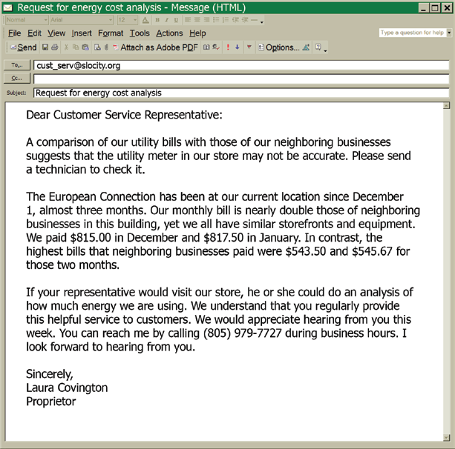
Sample

Slide 31
task: Review the sample response to a complaint/ claim letter when the buyer is at fault. Page .

Slide 32
Sample task.
Draft a letter complaining to the Customer Care Manager of the manufacturing firm about the poor quality of the household appliance you bought. Give details of problems being faced with the product and mention what you want.

Slide 33
2.2/3. Adjustment letters.
"An effective adjustment letter can not only repair any damage done but also restore the customer's confidence in your company.”

Slide 34
Writing adjustment letters.
Start with the good news.
Acknowledge/comply with the customer’s claim.
Sympathize with the customer.
Take or assign personal responsibility.
Explain how you’ll handle the situation.
Take steps to repair the relationship.
Follow up on your response.

Slide 35
Adjustment letters-outline
Third paragraph:
1. Close confidently by respecting & Appreciating the customer
2. If needed, apologize indirectly. (p.179)
3. If unable to comply with all elements of the requested adjustment, explain why and add any necessary details on how you will be responding to the request.
(sample closing sentences on p-179)
First paragraph:
1.Start with an approval sentence- give a good news first.
2. Acknowledge/comply with the customer’s claim. (sample opening sentences on p-178)
Second paragraph:
Explain the mistake- cause of the problem.
Focus on your ongoing efforts to avoid mistakes and difficulties.
Regain confidence.
Sensitive language. Don’t: blame, use negative words, or make un realistic claims.

Slide 36
Sample adjustment letters.
Task:
Go to page number_________ in you handout and differentiate between an effective adjustment letter and an ineffective adjustment letter.

Slide 37
Task: Write a claim and an adjustment letter.
Task for group 1. Situation.
You had recently bought a new mobile phone. After few days you realized that the phone`s screen is flickering, touch is not working properly and it is discharging the battery very early opposing your expectations.
Write a claim/complaint letter to the dealer specifying what you want to do with the phone and what you want the dealer to do.
Task for group 2.
Write an adjustment letter to the claim letter for the faulty mobile phone.

Slide 38
3/3. Asking for Recommendations
Opening
Direct Approach
Body
Include experience, background, skills
Close
Include a deadline and delivery information
Ask for recommend-ation and explain what you need it for.
Add any unique attributes
Express appreciation
Notes:
The need to inquire about people arises often in business. For example, before extending credit or awarding contracts, jobs, promotions, or scholarships, companies often ask applicants to supply references. Companies ask applicants to list people who can vouch for their ability, skills, integrity, character, and fitness for the job. Before you volunteer someone’s name as a reference, ask permission. Some people may not want their names used, perhaps because they don’t know enough about you to feel comfortable writing a letter or because
they or their employers have a policy of not providing recommendations.

Slide 39
Task: Review the Sample recommendation letter on page number 186.

Slide 40
TASK.
You have applied for a job of a software engineer at ABC company. Write a letter requesting one of your colleague from XYZ company you had been working with, to write a recommendation letter for you. Specify what you want him/her to write in the letter.

Slide 41
Providing Recommendations and References
PURPOSE:
to convince the reader that the person being recommended has the necessary characteristics for the job/task/objective the candidate is seeking.
Candidate’s Name
Position or Objective the
candidate is seeking
Your Relationship
Facts and Evidence relevant to
The candidate and the opportunity
Comparison with Peers
Your overall Evaluation of The
candidate`s suitability for job
Sample recommendation letter on page 186.
Notes:
If you decide to write a letter of recommendation, or respond to a request for information about a job candidate, your goal is to convince readers that the person being recommended has the characteristics necessary for the job, project assignment, or other objective the person is seeking. A successful recommendation letter contains a number of relevant details:
The candidate’s full name
The position or other objective the candidate is seeking
The nature of your relationship with the candidate
Facts and evidence relevant to the candidate and the opportunity
A comparison of the candidate’s potential with that of peers, if available
Your overall evaluation of the candidate’s suitability for the opportunity

Slide 42
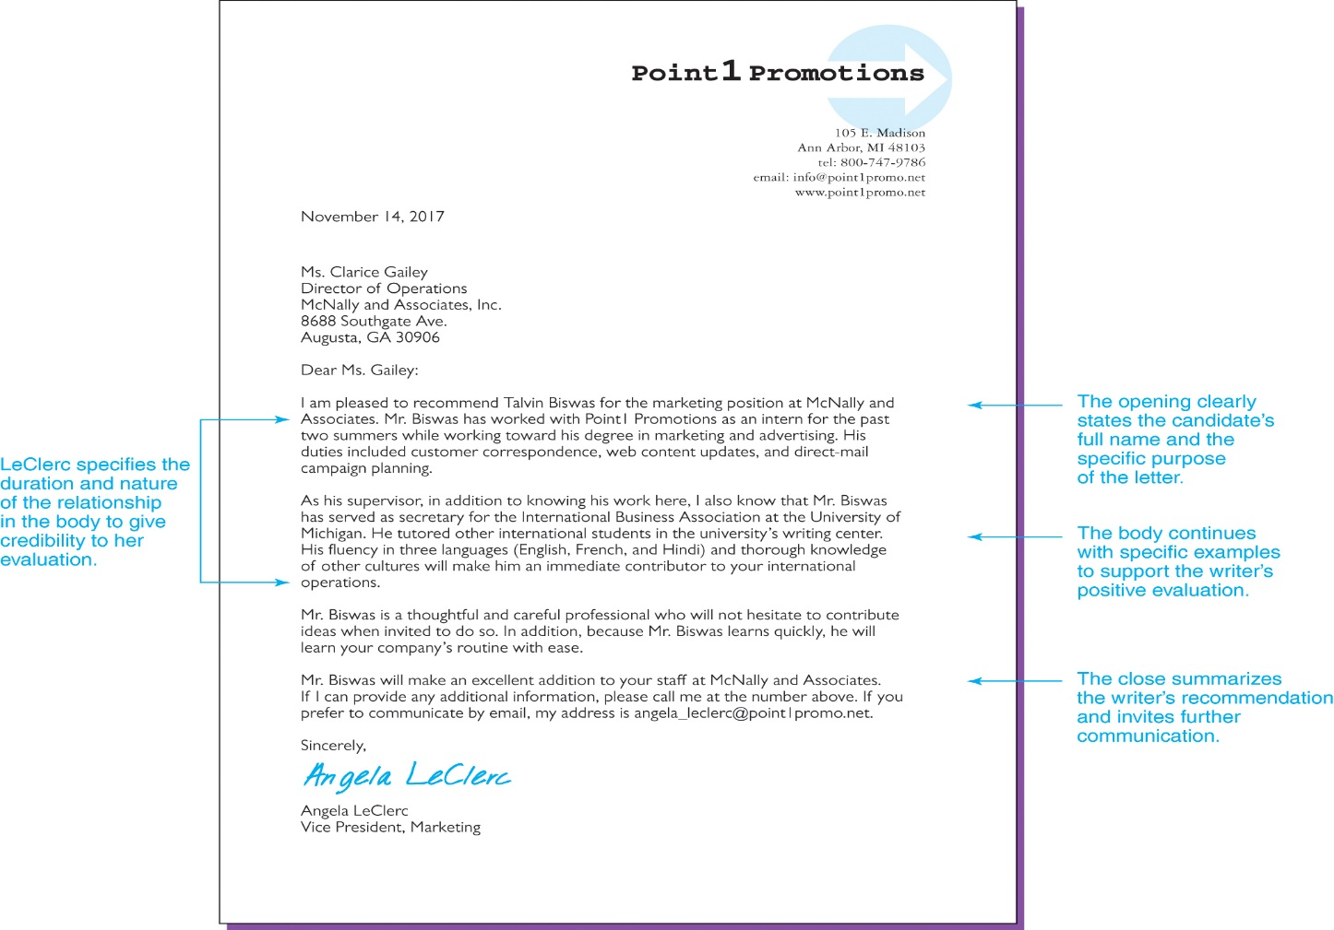
Effective Recommendation Letter
Notes:
Figure 8.5 Effective Recommendation Letter
This letter clearly states the nature of the writer’s relationship to the candidate and provides specific examples to support the writer’s endorsements.

Slide 43
Tasks. 1. review Sample recommendation letter on page 186. 2. write a recommendation letter to your colleague WHO has applied for the post of software engineer at a.b.c. company.

